Slide 1



IMPLEMENTING DOCTOR'S CURSIVE HANDWRITING DECIPHERING SYSTEM WITH DEEP LEARNING USING OCR
Presented By Khushi.J.H, Ishani Singh

Slide 2

Intro
Project Overview
This software project aims to tackle the problem of deciphering illegible handwritten content in doctors' prescriptions using technologies like OpenCV, OCR, and Pytesseract. It compiles diverse samples to recognize various handwriting styles and transform them into legible text, enhancing readability for medical professionals and others. The software is intended for both computers and mobile devices, promoting wider accessibility. Beyond healthcare, it has broader applications in improving text comprehension for computers, potentially advancing technology in regions like Indonesia. Ultimately, the project seeks to simplify complex medical data, making it accessible and usable for a diverse audience, contributing to improved information accessibility.

Slide 3
Contents
Table Of Contents
01
INTRODUCTION
03
PROPOSED SYSTEM
02
TOOLS USED
04
ALGORITHM

Slide 4
Chapter 1
Introduction
Deciphering doctors' notoriously illegible cursive handwriting in medical prescriptions is a critical issue due to the potential for serious consequences, exemplified by real-life incidents like a tragic prescription misinterpretation. To tackle this challenge, a comprehensive model is proposed, employing a Deep Convolutional Recurrent Neural System to recognize and decipher text in doctors' handwritten scripts. The aim is to significantly enhance the readability and understanding of medical scripts for healthcare professionals and non-medical individuals. By reducing errors caused by illegible handwriting, this technology could mitigate risks and streamline the translation of complex cursive scripts into clear, comprehensible text, thereby ensuring safer medical practices and preventing potentially fatal medication errors.

Slide 5
Chapter 2
Proposed System
Machine Learning and Neural Networks:
Feature Engineering
Algorithm Selection
Model Development
Validation and Performance Evaluation:
Dataset Splitting
Accuracy Assessment
Fine-tuning
System Integration and Application:
Framework Development
User Interface Development
Continuous Improvement and Maintenance:
Feedback Loop
Data Collection and Preprocessing:
Acquire Diverse Medical Scripts
Image Preprocessing:
Normalize and Clean Images
Handwriting Image Extraction:
Region of Interest Detection
Text Localization
Optical Character Recognition (OCR):
Model Selection
Training and Testing:
Train OCR Models
Fine-tune Models

Slide 6
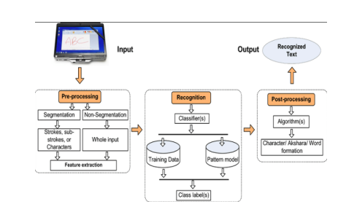
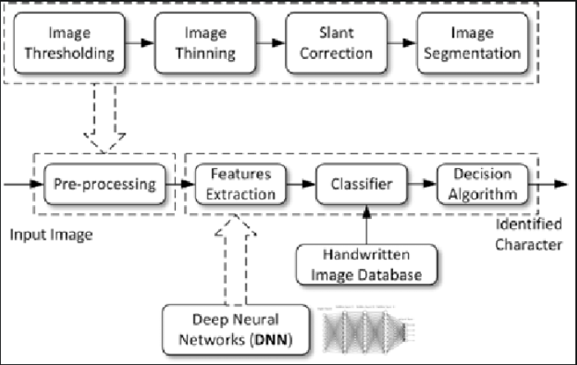
SYSTEM ARCHITECTURE

Slide 7
Tools Used
Chapter 3
OpenCV for Image Preprocessing:
Normalize, enhance, and optimize handwritten prescription images using OpenCV.
Apply filters, thresholding, edge detection, and segmentation for better text region isolation.
Augment data with techniques like rotation, flipping, and noise to enhance the training dataset.
Pi Tesseract for OCR Integration:
Utilize Pi Tesseract with OpenCV for Optical Character Recognition.
Extract text from processed images, transcribe handwriting to machine-encoded text.
Obtain and store recognized output for further analysis.
Pillow (PIL Fork) for Image Handling:
Use Pillow to open, manipulate, and format images.
Convert between image file formats and make necessary adjustments for improved OCR compatibility.

Slide 8
Chapter 4
Algorithm
Input Acquisition
Preprocessing and Noise Reduction
Text Extraction with OCR (Pytesseract or Keras)
Text Normalization and Formatting
Transformer-Based Text Recognition
Post-Recognition Processing and Output
End of Algorithm

Slide 9
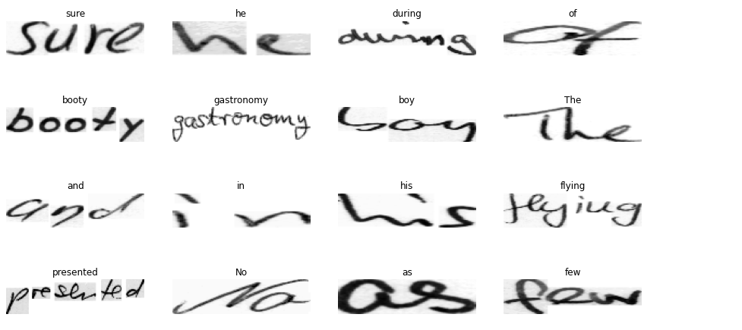
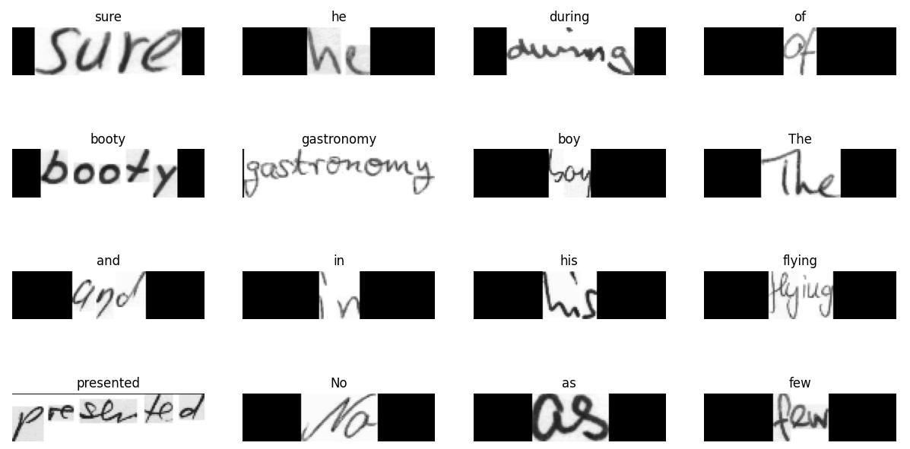
Some sample images with the corresponding words from dataset
Sample images resized and processed

Slide 10
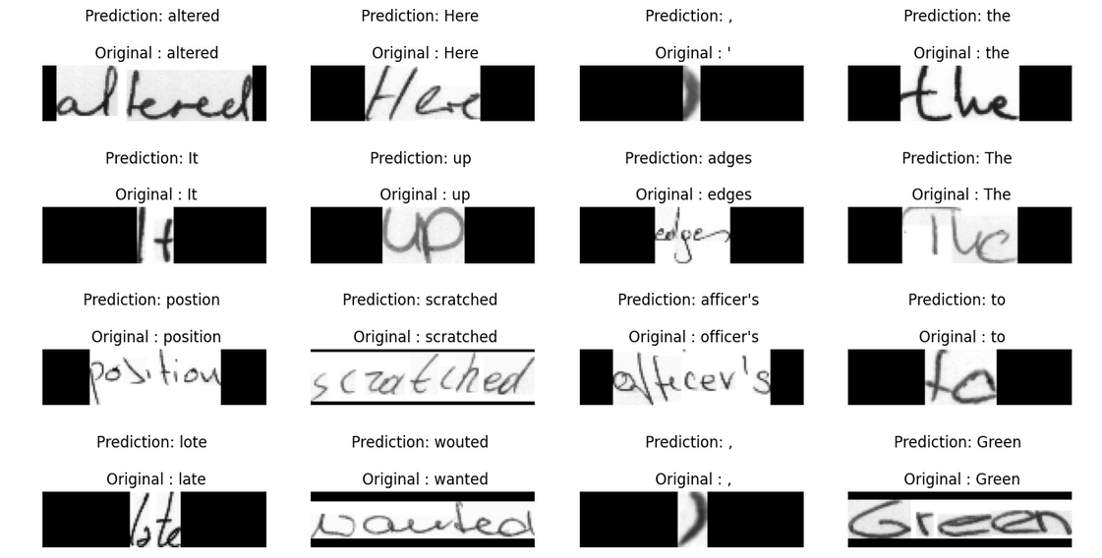
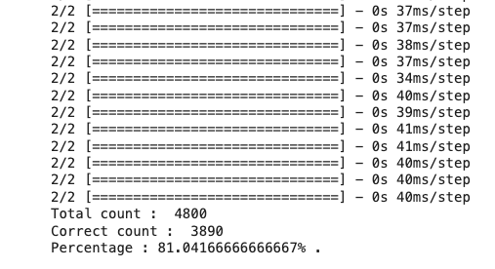
<Some samples with the predicted and actual text from the dataset
Total and corrected count with percentage accuracy>

Slide 11
Group Result
Result 1
Result 2
Result 3
Working with datasets and directories in colab and image processing using opencv
Creating, training, and evaluating deep learning models for handwriting recognition.
Creating, training, and evaluating deep learning models for handwriting recognition. The importance of making predictions and visualizing the results to interpret and understand the model's performance.
Working with TensorFlow and Google Colab was a practical learning experience. Utilizing libraries and cloud-based platforms is a common practice in machine learning projects.

Slide 12
Conclusion
In conclusion, the project showcases the effective integration of image processing and OCR techniques, presenting a solution to the challenge of deciphering complex cursive handwriting prevalent in medical documents. The automated system offers a tangible means to convert and process illegible handwritten medical prescriptions, thereby facilitating enhanced accessibility and readability for healthcare professionals.

Slide 13
THANK YOU
By Khushi.J.H and Ishani Singh

